Slide 1
Vedra: Eco Lifestyle Agent
CAPSTONE PROJECT
Presented By:
Suryank Malik- ABES Engineering College-Computer Science

Slide 2
OUTLINE
Problem Statement (Should not include solution)
Proposed System/Solution
System Development Approach (Technology Used)
Algorithm
Deployment
Result (Output Image)
Conclusion
Future Scope
References

Slide 3
Problem Statement
An Eco Lifestyle Agent, built with Watsonx Assistant, helps users adopt a greener lifestyle by providing practical and personalized eco-friendly advice. It answers natural language questions like “How can I reduce plastic use at home?” or “What are eco-friendly travel options in my city?” with quick, easy-to-understand suggestions. The assistant gives tips on sustainable living, recommends eco-conscious products, shares local recycling practices, and highlights helpful government programs. By promoting simple daily habits that have a big impact, it makes sustainability easier to navigate. This chatbot encourages environmentally responsible choices and supports a cleaner, greener future for everyone.

Slide 4
Proposed Solution
Mood-Aware Eco Suggestions
Using sentiment detection, it changes responses based on your tone. If you seem stressed or tired, it says: “Take a walk in the park today. It’s good for you and the Earth".
A Game-Like Missions
Users receive fun daily missions to make eco-friendly choices. “Your Quest Today: Refuse two plastic bags.
Reward: This makes the journey interactive and engaging.
Build a Digital Clone of Your Lifestyle
The agent builds a virtual “EcoTwin” – a profile of your lifestyle footprint based on what you search and the
actions you take.
It visualizes: Your carbon footprint, Water saving score , Plastic-free days

Slide 5
System Approach
System requirements-
Hardware Requirements:
Device: Any device with a modern web browser, including a laptop, desktop, tablet, or mobile Internet
A stable internet connection
Software Requirements:
IBM Cloud account (Lite or Standard)
IBM Watsonx Assistant enabled
Optional: Watson Discovery / RAG integration for external knowledge
Optional: IBM Cloud Object Storage for storing large documents or FAQs

Slide 6
System Approach
Requirements to build the model
Watsonx Assistant: the main conversational AI framework, focuses on intent handling, dialogue design, and user flow.
Prompt Templates: provide predefined responses and follow-up actions for FAQs.
Actions UI: a visual flow builder that allows you to design no-code or low-code conversational paths.
Web Chat Integration: lets you embed a chatbot in a website, mobile app, or portal.
Watsonx.ai: is an optional feature for future AI services such as RAG or sentiment-aware answers.
Cloud Object Storage: enables you to store PDFs, knowledge bases, or eco-related datasets if needed.
Assistant Analytics: helps you track user interactions, the most common queries, and user feedback.

Slide 7
Algorithm
Unlike traditional ML prediction systems, the Eco Lifestyle Agent uses rule-based conversational logic and intent recognition within Watsonx Assistant. This method was selected because the main goal is to provide real-time, actionable eco-suggestions based on user queries. It does not aim to predict future outcomes.
Watsonx Assistant employs intent classification, entity recognition, and dialogue flow management to understand user input and offer personalized guidance. For improved intelligence, it can optionally integrate retrieval-based systems like RAG (Retrieval-Augmented Generation)

Slide 8
Deployment
The Eco Lifestyle Agent is set up through the following steps:
1. Build and Train Assistant
Create intents, entities, and actions in Watsonx Assistant.
Configure custom prompts and branching logic.
2. Test on Preview Interface
Use Watson’s preview panel to simulate conversations.
3. Deploy on Platform of Choice
Use Web Chat integration to embed the assistant in websites or mobile apps.
You can also integrate with WhatsApp, Slack, or MS Teams.
4. Monitor and Improve
Use Watson Assistant’s built-in analytics to monitor user engagement.
Regularly update eco content, adjust flows, and add new features like EcoTwin or Mood-aware nudges.

Slide 9
Result
The Eco Lifestyle Agent provides personalized, real-time eco-tips with Watsonx Assistant. It understands user questions naturally and encourages daily sustainability. It also offers local green suggestions. The assistant is responsive and easy to use, helping users make environmentally friendly choices with ease.

Slide 10
Conclusion
By combining technology with sustainability, this agent helps users make conscious, eco-friendly choices every day. Using Watsonx Assistant, it provides relatable, real-time advice and gamified tips that make green living easier. The platform builds lasting habits with a personal touch, encouraging users to take part in protecting the planet.

Slide 11
Future scope
In the future, the Eco Lifestyle Agent can develop into a smarter, more engaging sustainability companion. It can connect with IoT and smart home devices to track energy and water use in real time, leading to more accurate eco-suggestions. A personalized eco-dashboard can show user impact, like carbon savings and plastic-free streaks. Voice assistant integration can provide hands-free, real-time advice during daily tasks. With location-based support, the agent can recommend local green events, recycling centers, or public transport options. Adding regional languages would make it available to different communities. Gamified eco-rewards and community challenges would encourage participation and motivation. Partnerships with eco-brands and NGOs can provide exclusive green deals and volunteering opportunities. Finally, by using Watsonx.ai, the agent can become smarter over time and adapt to user habits, creating highly personalized sustainability experiences.

Slide 12
References
ChatGpt- Conceptualized & co-developed with OpenAI ChatGPT for intelligent eco guidance
ChatGPT
UN Environment Programme (UNEP)– Global eco-tips, sustainable lifestyle resources
UNEP
MNRE (Ministry of New and Renewable Energy) – Solar rooftop, EV & green energy schemes MNRE
MoEFCC (India Environment Ministry) – Govt. schemes, recycling rules, plastic bans
MoEFCC
Watson Assistant Documentation – IBM setup, training, and integration help :
IBM Cloud Docs

Slide 13
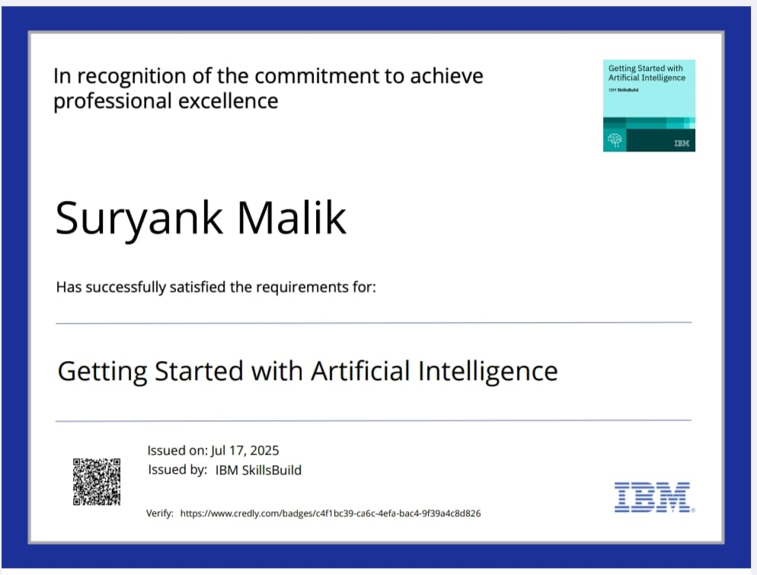
IBM Certifications

Slide 14
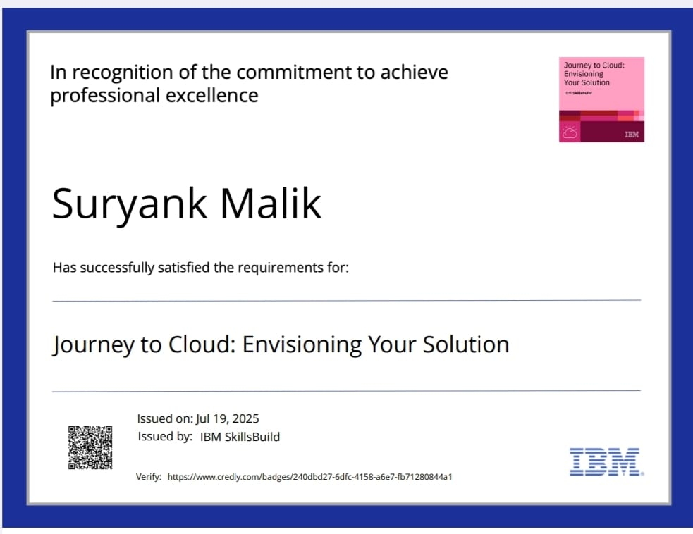
IBM Certifications

Slide 15
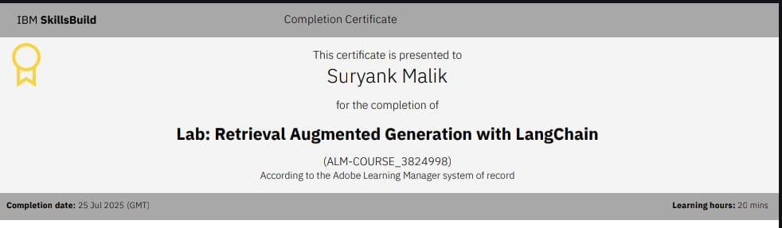
IBM Certifications

Slide 16
THANK YOU

